Slide 1
CLIENT-SIDE-SCRIPT
JAVASCRIPT

Slide 2
CONTENTS
Introduction to Client Side Script
Introduction to JavaScript
  JavaScript simple program
  Methods
  Variables
  Control Structures
    Selection
    repetition

Slide 3
CLIENT-SIDE SCRIPTS
Client-side scripts refers to computer programs on the web that are executed at client side by web browsers.
  It can be used to enhance functionality and appearance:
  Validate user inputs entered on HTML forms
  Makes pages more dynamic and interactive
  Pages can produce immediate response without contacting a server

Slide 4
CLIENT-SIDE SCRIPTS
Not all browsers support scripts.
Cannot connect to databases.
Limited interactions to system resources

Slide 5
INTRODUCTION TO JAVASCRIPT
JavaScript scripting language
  Originally created by Netscape.
  is design to add interactivity to HTML pages.
  Consist of lines of interpretable computer code.
  Is usually embedded directly into HTML pages.
Jscript
  Microsoft’s version of JavaScript

Slide 6
JAVASCRIPT AND HTML PAGE
Tells where the JavaScript starts
<html>
<body>
<script type=“text/javascript”>
document.write(“Hello World!”);
</script>
</body>
</html>
Commands for writing output to a page
Tells where the JavaScript ends

Slide 7
JAVASCRIPT
<SCRIPT>…</SCRIPT> tag:
  Encloses entire script
  Attribute LANGUAGE=“JavaScript” or
  <SCRIPT type = "text/javascript">
    Indicates scripting language (JavaScript default in IE5 & Netscape)
  Tag must be closed at the end of the script

Slide 8
JAVASCRIPT
Correct method call syntax:
  object.method( “string”, “[additional arguments]” );
document.writeln( “<H1>TEXT</H1>” );
  Case-sensitive
  Uses the writeln method in the browser’s document object
  Prints the string, which can consist of any text and HTML tags
  String must be surrounded by quotation marks (“…”)
Statement terminators
  All statements must end with semi-colons (;)

Slide 9
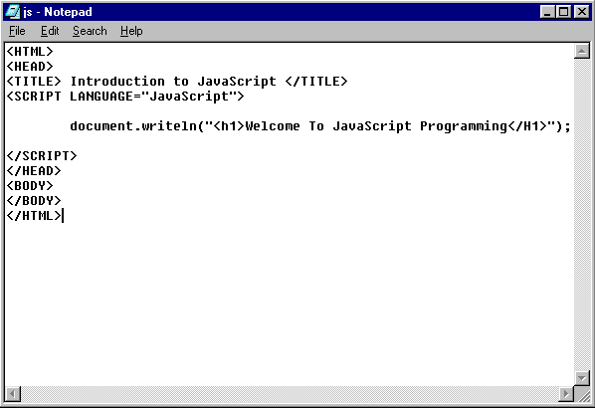

Slide 10
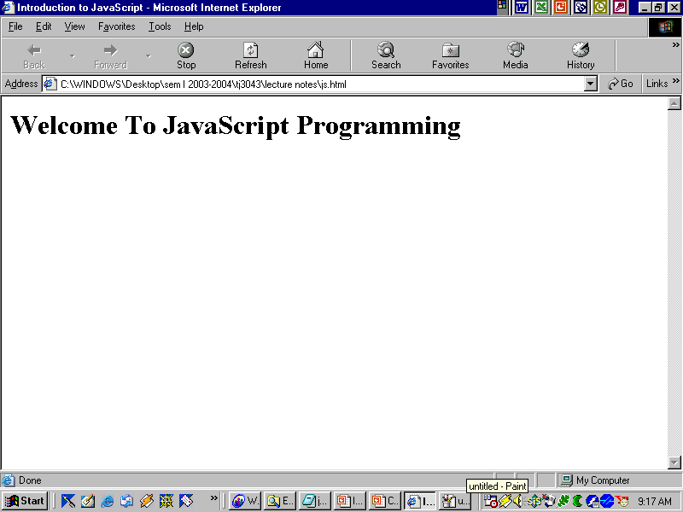

Slide 11
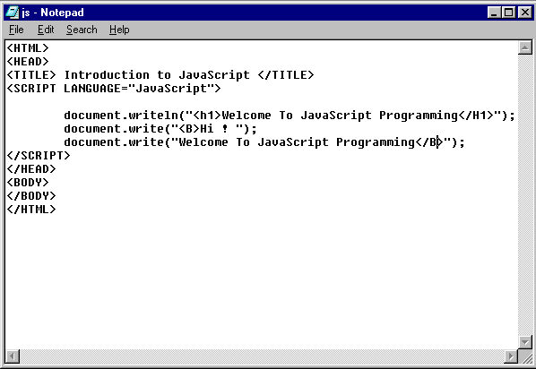

Slide 12
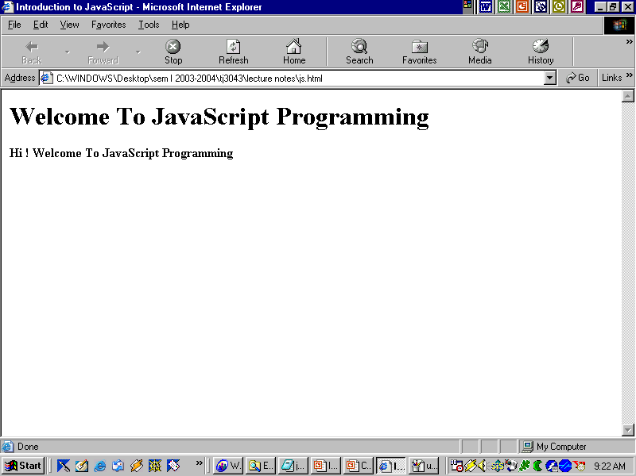

Slide 13
OBJECT: DOCUMENT
Methods:
  writeln
    Add a new line after each statement.
  write
    Does not add a new line after each statement.
  Both begin output where previous statement stopped
  Line breaks inserted in two ways:
    document.writeln( “Hello World!”);
    document.write( “Have a nice day!<br>” )

Slide 14
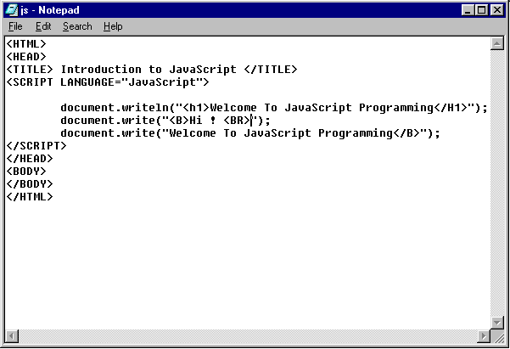

Slide 15
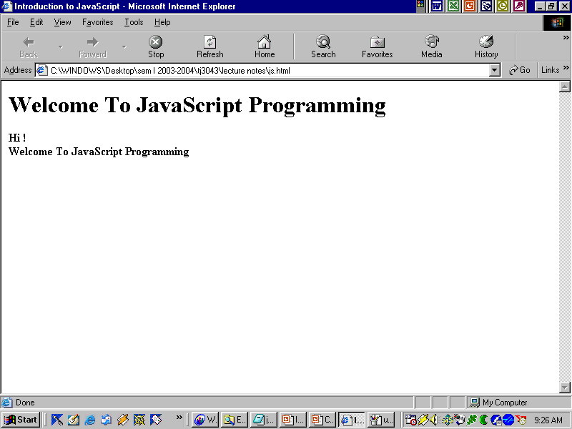

Slide 16
OBJECT : WINDOW
Methods:
  Call on-screen windows
  window.alert( “argument” );
    Method calls alert window with window text "argument"
    Outputs button with text and ‘OK’ button
  window.prompt(“arg1”, “arg2” );
    Calls window that allows user to enter value to use in the script
    arg1 : text that will appear in window
    arg2 : text that will initially appear in input line
  window.confirm(“argument“);
    Outputs button with text and ‘OK’ and “CANCEL” button
    Scripts restart when page reloaded/refreshed

Slide 17
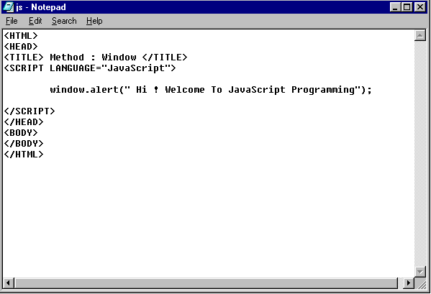

Slide 18
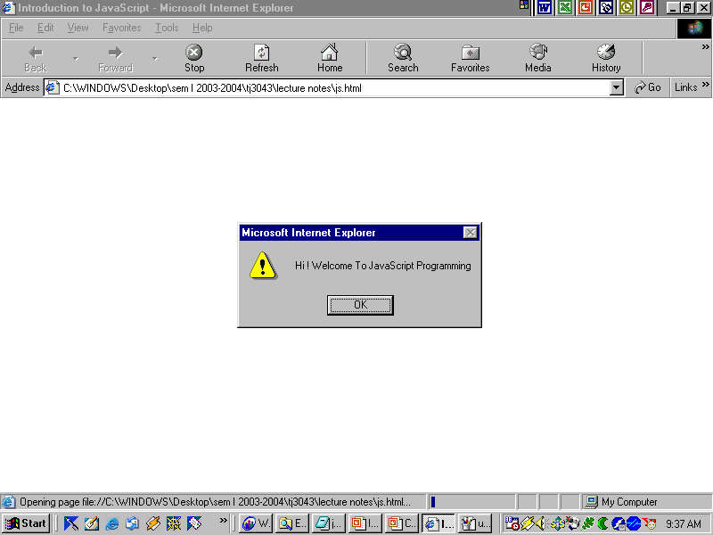

Slide 19
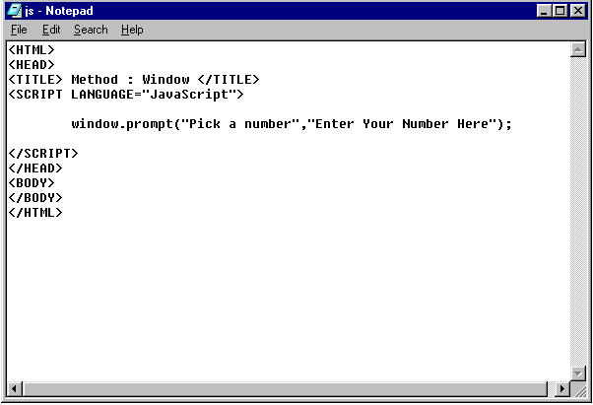

Slide 20
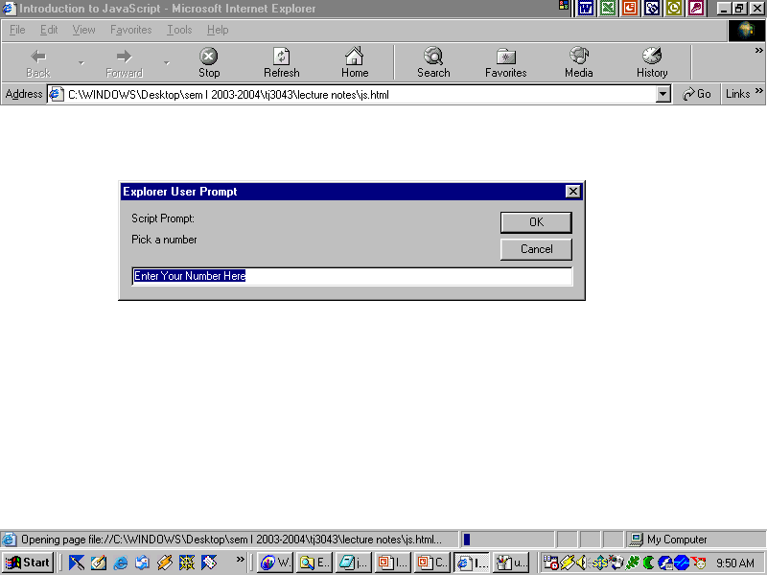

Slide 21
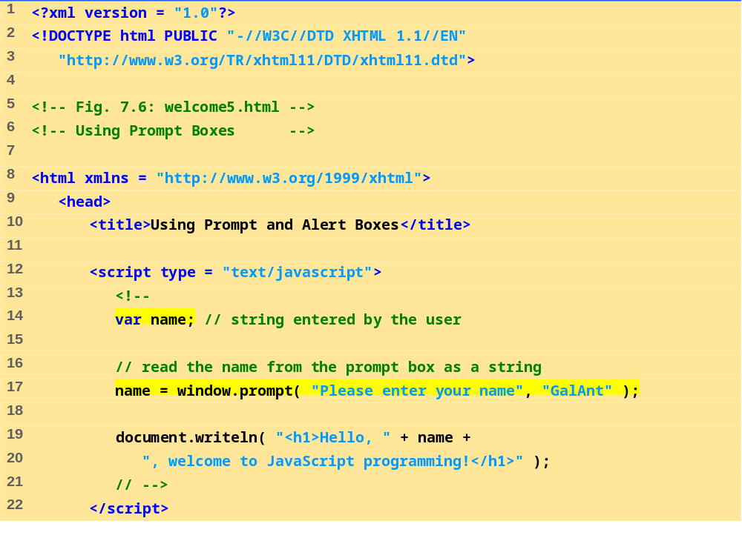
WELCOME5.HTML
(1 OF 2)
← Value returned by the prompt method of the window object is assigned to the variable name
“+” symbol can be used for text concatenation as well as arithmetic operator

Slide 22
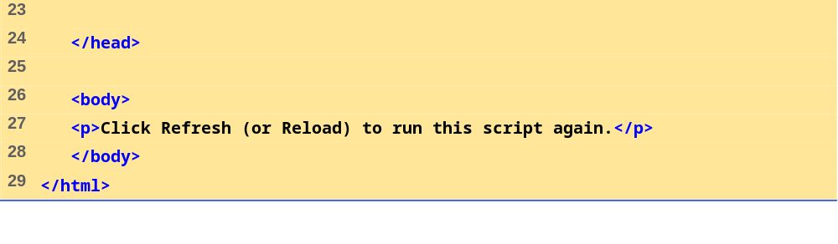
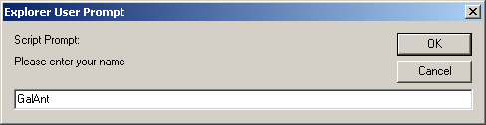
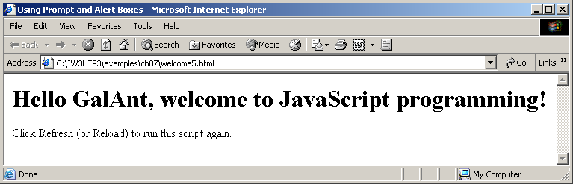

Slide 23
When the user clicks OK, the value typed by the user is returned to the program as a string.
This is the prompt
to the user.
This is the text field in which the user types the value.
If the user clicks Cancel, the null value will be returned to the program and no value will be assigned to the variable.
This is the default value that appears when the dialog opens.

Slide 24
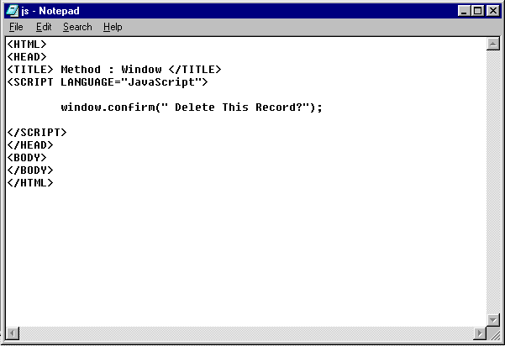

Slide 25
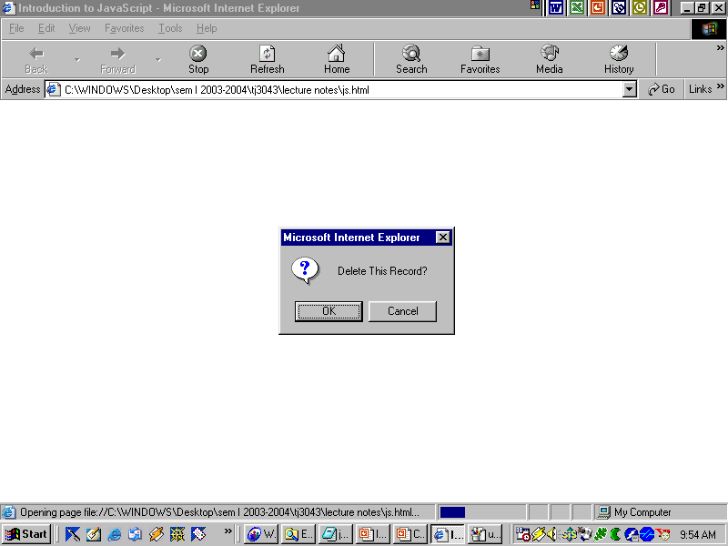

Slide 26
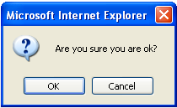
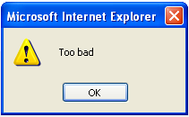
<script type="text/javascript">
var x;
x=window.confirm("Are you sure you are ok?")
if (x)
window.alert("Good!“)
else
window.alert("Too bad");
</script>
What is the value of x?

Slide 27
VARIABLES
Variables
  Are containers for storing information.
  Variable name can be any valid identifier
    Identifier = series of characters
      Letters, digits, underscores (‘_’) and dollar signs (‘$’)
      Cannot begin with a digit
    Valid identifiers:
    Welcome, $value, _value, m_inputField1, C3PO and R2D2
    Invalid identifiers: 7button, Say\Hello and field#5
  Are case-sensitive - i.e “myVar” is not the same as “myvar”.
  Javascript is a loosely typed language.
    Variables store any data type depending on the value assigned.

Slide 28
VARIABLES
Variable name convention
  Begin with lowercase first letter or underscore character
  Every following word has first letter capitalized
    goRedBox, bostonUniversityRules
Declarations
  var firstName, lastName ;
  Indicate that firstName and lastName are program variables

Slide 29
VARIABLES AND DATA TYPES
Type of a variable is dynamic: depends on the type of data it contains
JavaScript has six data types:
  Number
  String
  Boolean (values true and false)
  Object
  Null (only value of this type is null)
  Undefined (value of newly created variable)

Slide 30
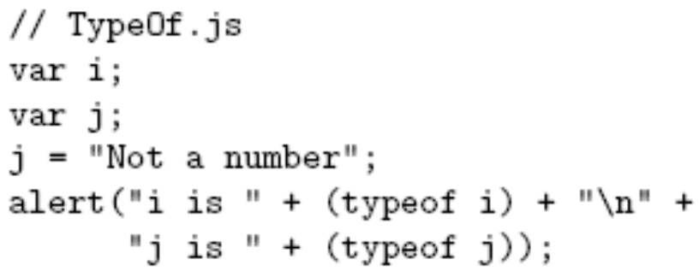
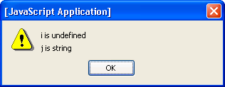
VARIABLES AND DATA TYPES
typeof operator returns string related to data type
  Syntax: typeof expression
Example:

Slide 31
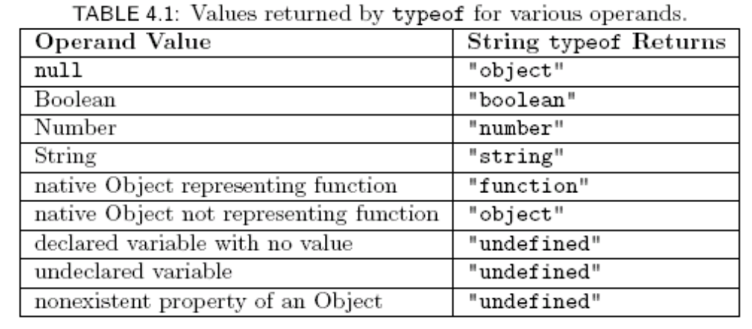
VARIABLES AND DATA TYPES

Slide 32
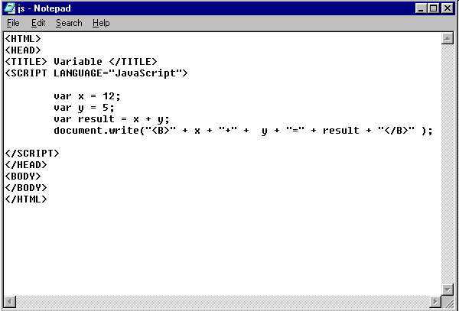

Slide 33
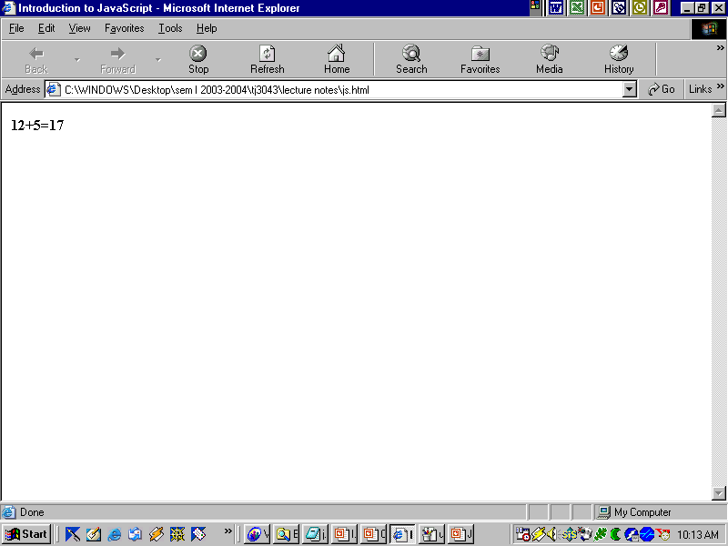

Slide 34
Formating a Numbers
For rounding decimals you can use the built-in JavaScript methods toFixed or toPrecision.
var num = 930.9805;
var result = num.toFixed(3); // result will equal 930.981
num = 10;
result = num.toFixed(2); // result will equal 10.00
num = 500.2349;
result = num.toPrecision(4); // result will equal 500.2
num = 5000.2349;
result = num.toPrecision(4); // result will equal 5000
num = 555.55;
result = num.toPrecision(2); // result will equal 5.6e+2

Slide 35
CONVERT NUMBERS FROM STRINGS TO INTEGERS
parseInt();
  Function accepts a string and returns an integer value
    Not a method because we do not refer to an object name
  number1 = parseInt( firstNumber );
  Operates right-to-left (due to the "=" sign)

Slide 36
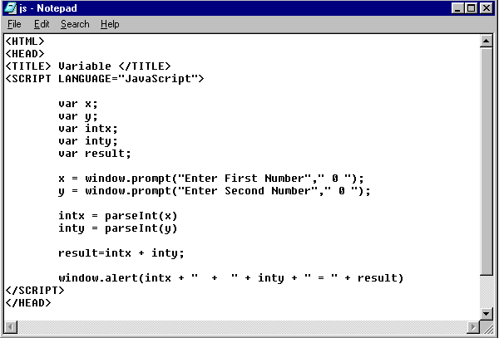

Slide 37
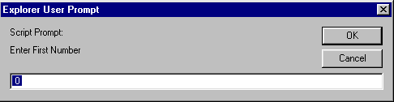
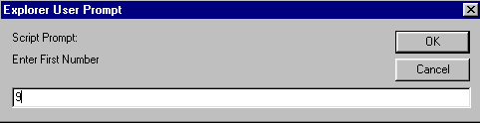

Slide 38
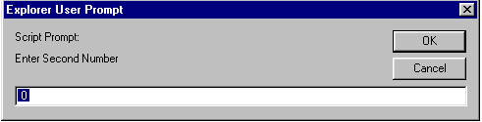
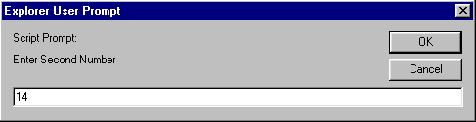

Slide 39
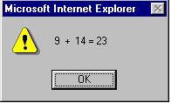

Slide 40
CONTROL STRUCTURE
Selection
  if
  if/else
  switch
Repetition
  while
  do/while
  for
  for/in

Slide 41
SELECTION
3 Types of selection structures
  if
    Single-selection structure
      Selects or ignores a single action or group of actions
  if/else
    Double-selection structure
      Selects between two actions or groups of actions
  switch
    Multiple-selection structure
      Selects among many actions or groups of actions

Slide 42
IF /ELSE SELECTION
JavaScript statement:
  if( grade >= 60 )
  document.writeln( “Passed” );
  else
  document.writeln( “Failed” );

Slide 43
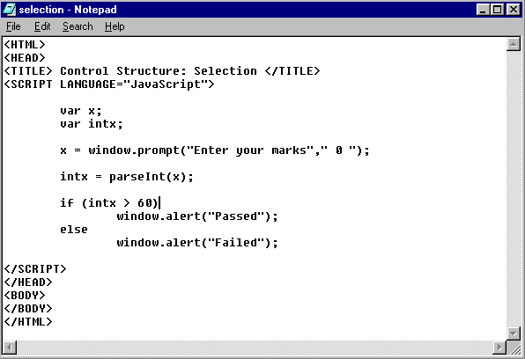

Slide 44
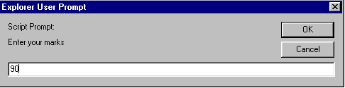
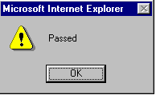

Slide 45
IF /ELSE IF SELECTION
  if ( studentGrade >= 90 )
  document.writeln( “A” );
  else
  if ( studentGrade >= 80 )
  document.writeln( “B” );
  else
  if ( studentGrade >= 70 )
  document.writeln( “C” );
  else
  if ( studentGrade >= 60 )
  document.writeln( “D” );
  else
  document.writeln( “F” );

Slide 46
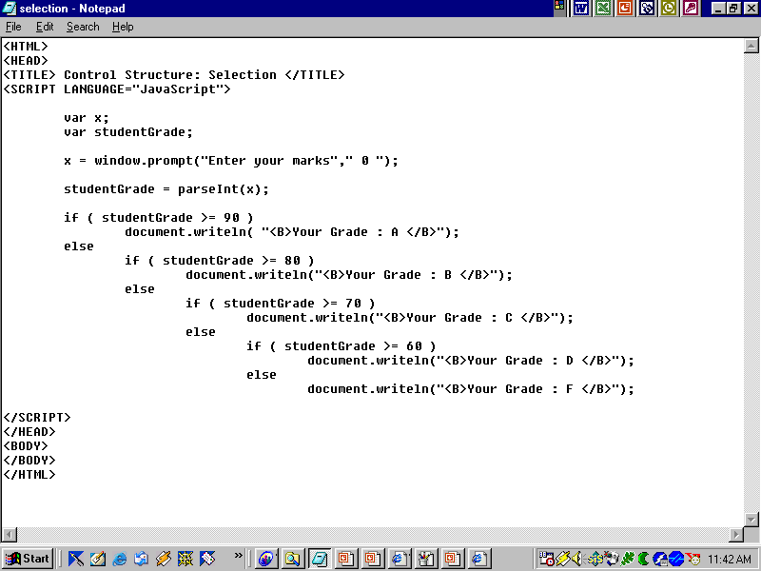

Slide 47
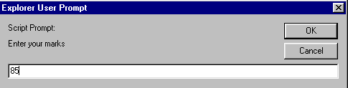
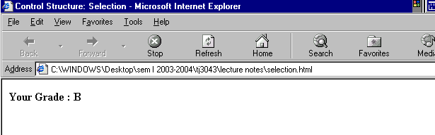

Slide 48
IF /ELSE SELECTION
{ } : more than one statement
Var grade = 50;
if ( grade >= 60 )
  document.writeln( “Passed” );
  else {
  document.writeln( “Failed<BR>” );
  document.writeln( “You must take the
  course again.” );
  }

Slide 49
SWITCH SELECTION
JavaScript statement:
  var choice;
  choice = window.prompt();
  switch ( choice ) {
  case “a”:
  actions
  case “b”:
  actions
  case “z”:
  actions
  default:
  actions
  }

Slide 50
BREAK & CONTINUE
break;
  Skips to end of switch structure
  Should be at the end of every case sub-structure
  If left out, JavaScript will continue to test user input against cases
  Exits structure
break;
  Exits structure (for, do while)
continue;
  Skips remaining statements in structure; continues with next loop iteration

Slide 51
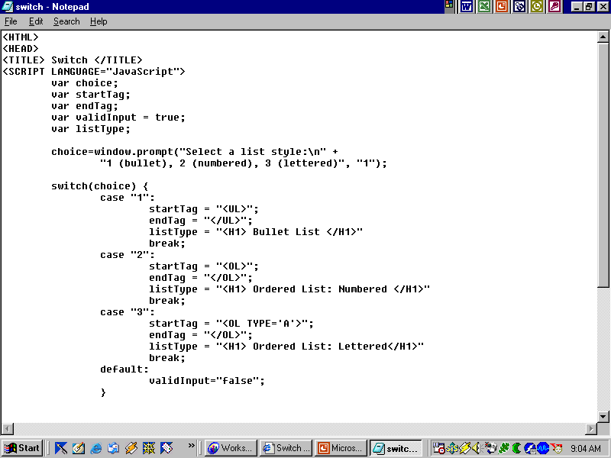

Slide 52
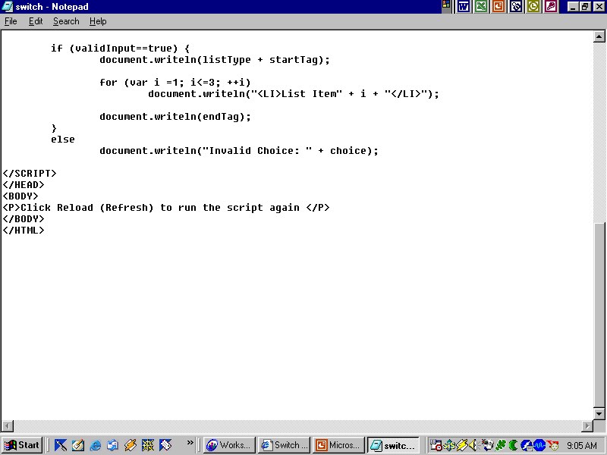

Slide 53
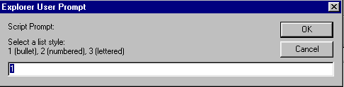
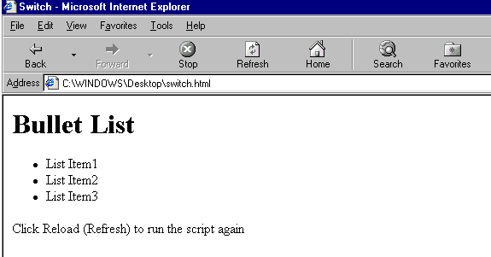
User Input : 1
User Output

Slide 54
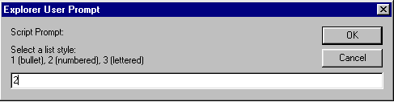
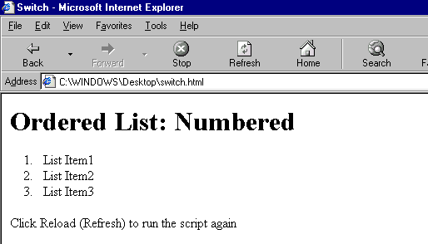
User Input : 2
User Output

Slide 55
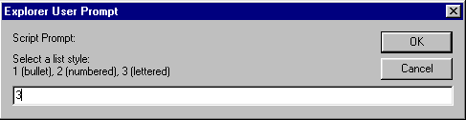
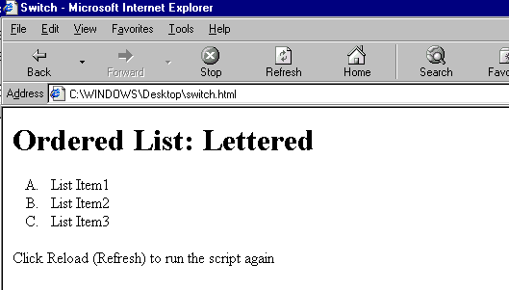
User Input 3
User Output

Slide 56
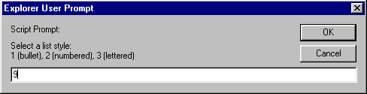
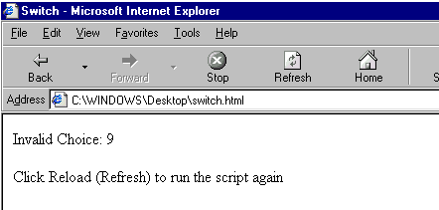
User Input : else
User Output

Slide 57
REPETITION
Four types of repetition structures
  while
  do/while
  for
  for/in

Slide 58
WHILE…
while structure:
  initialization;
  while ( loopContinuationTest ) {
  statement;
  increment;
  }

Slide 59
DO/WHILE…
Similar to while control structure
Difference
  while: structure only executes if condition is initially true
    JavaScript statement:
    while ( condition ) {
    statement
    }
  do/while: structure always executes at least once
    JavaScript statement:
    do {
    statement
    } while ( condition );

Slide 60
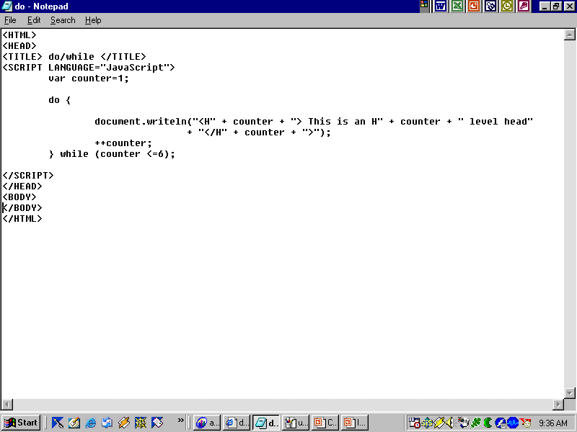

Slide 61
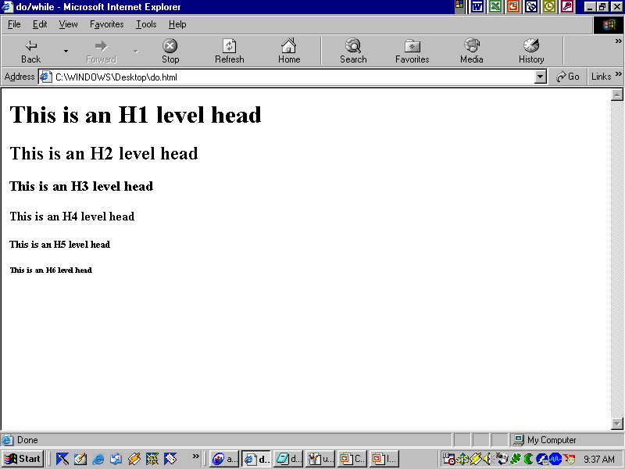

Slide 62
FOR
for repetition structure:
  Handles all details of counter-controlled repetition
  for ( initialization; loopContinuationTest ; increment )
  statement;
JavaScript statement:
  for ( var num = 1 ; i <= 7 ; num++ )
  document.writeln( “<P><FONT SIZE =” + num + “>HTML Font size ” + num + “</FONT>” );

Slide 63
EQUIVALENT STRUCTURES
for structure:
  for ( initialization; loopContinuationTest ; increment )
  statement;
while structure:
  initialization;
  while ( loopContinuationTest ) {
  statement;
  increment;
  }

Slide 64
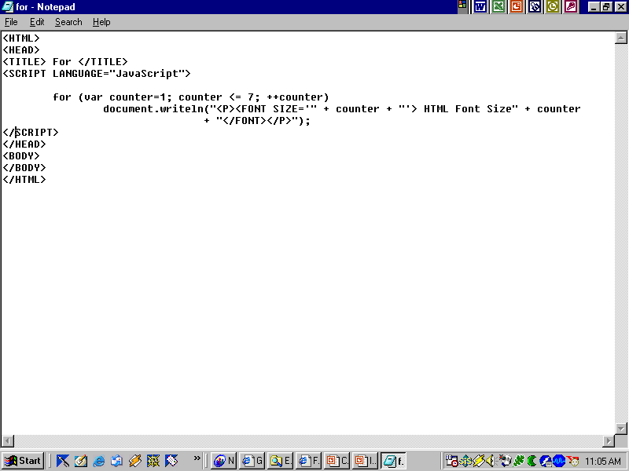

Slide 65
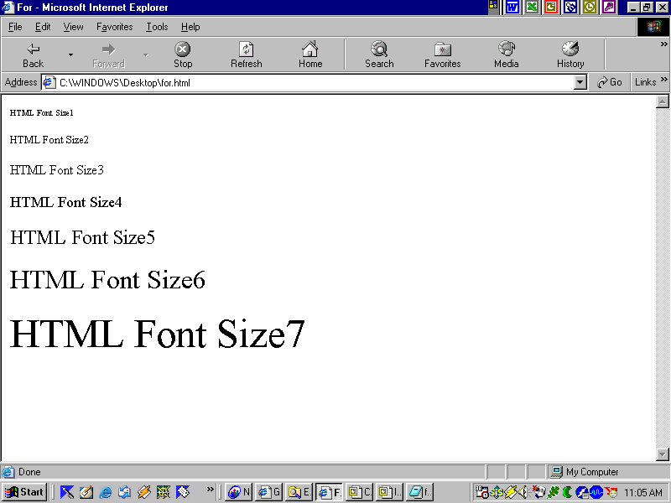

Slide 66
EXAMPLES : FOR
Different methods for varying control variable in for structure
Examples
  Control variable: 1 to 100, increments of 1:
    for ( var i = 1; i <= 100; ++i )
  Control variable: 100 to 1, increments of –1 (decrements of 1):
    for ( var i = 100; i >= 1; --i )
  Control variable 7 to 77: , steps of 7:
    for ( var i = 7; i <= 77; i += 7 )
  Control variable over sequence of values: 99, 88, 77, 66, 55, 44, 33, 22, 11, 0
    for ( var k = 99; k >= 0; k -= 11 )

Slide 67
QUIZ
<body>
If the value of a and b as below <br>
a : <input type "text" name = "val_a" value = 10> <br>
b : <input type "text" name= "val_b" value = 12> <br>
<SCRIPT type = "text/javascript">
var a = document.getElementById("val_a");
var b = document.getElementById("val_b");
y = Number(a. ) + (b.value) ;
document.write("The value of y is : " + y);
window.alert(y);
</SCRIPT>
</body>

